Slide 1
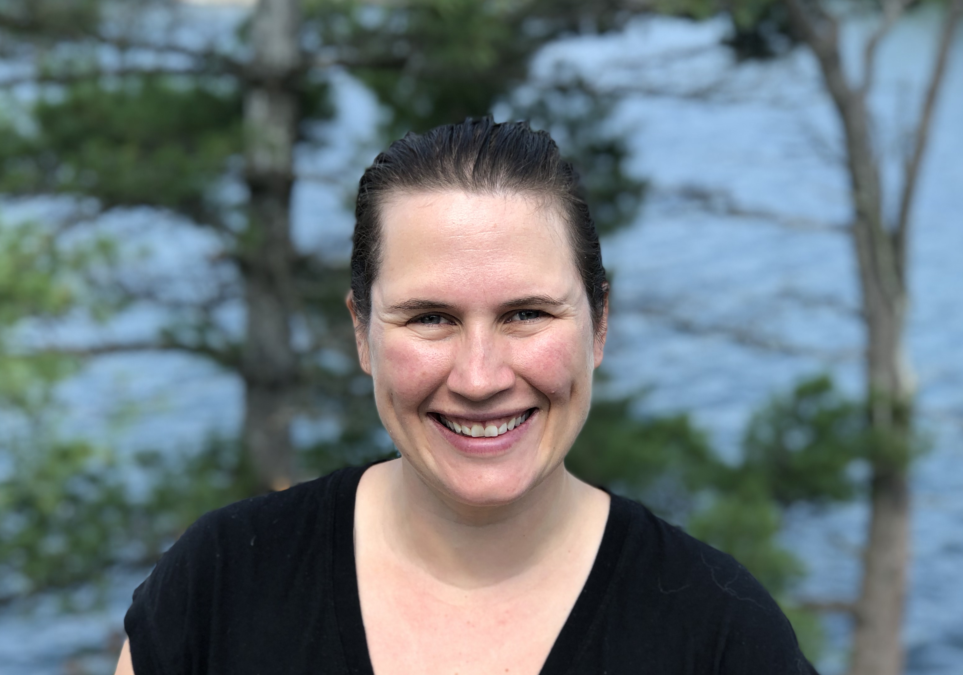
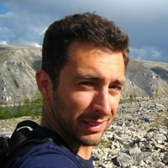
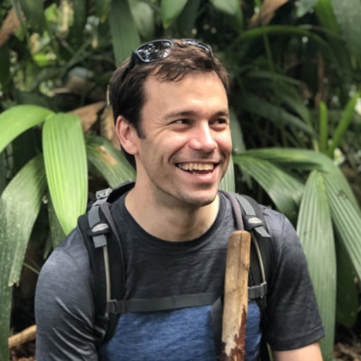
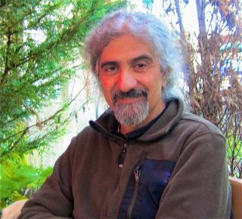
Mapping Forest Aboveground Biomass Density for the ABoVE Domain Circa 2020 with ICESat-2
Laura Duncanson, University of Maryland, College Park
Amy Neuenschwander, University of Texas at Austin
Paul Montesano, NASA GSFC
John Armston, University of Maryland
Ralph Dubayah, University of Maryland

Slide 2
Science Objectives
Develop ICESat-2 biomass models representative of the ABOVE domain using existing field plot data and discrete return airborne lidar data
2) Produce a boreal forest biomass density map for the ABoVE domain 2019-2021 using ICESat-2 data and Landsat
3) Utilize data from the 2017 and 2019 LVIS campaign for product validation
4) Assess the biomass change associated with disturbance agents (harvest, fire, NSR) through the use of existing 35 year disturbance products and a 2010 biomass map

Slide 3
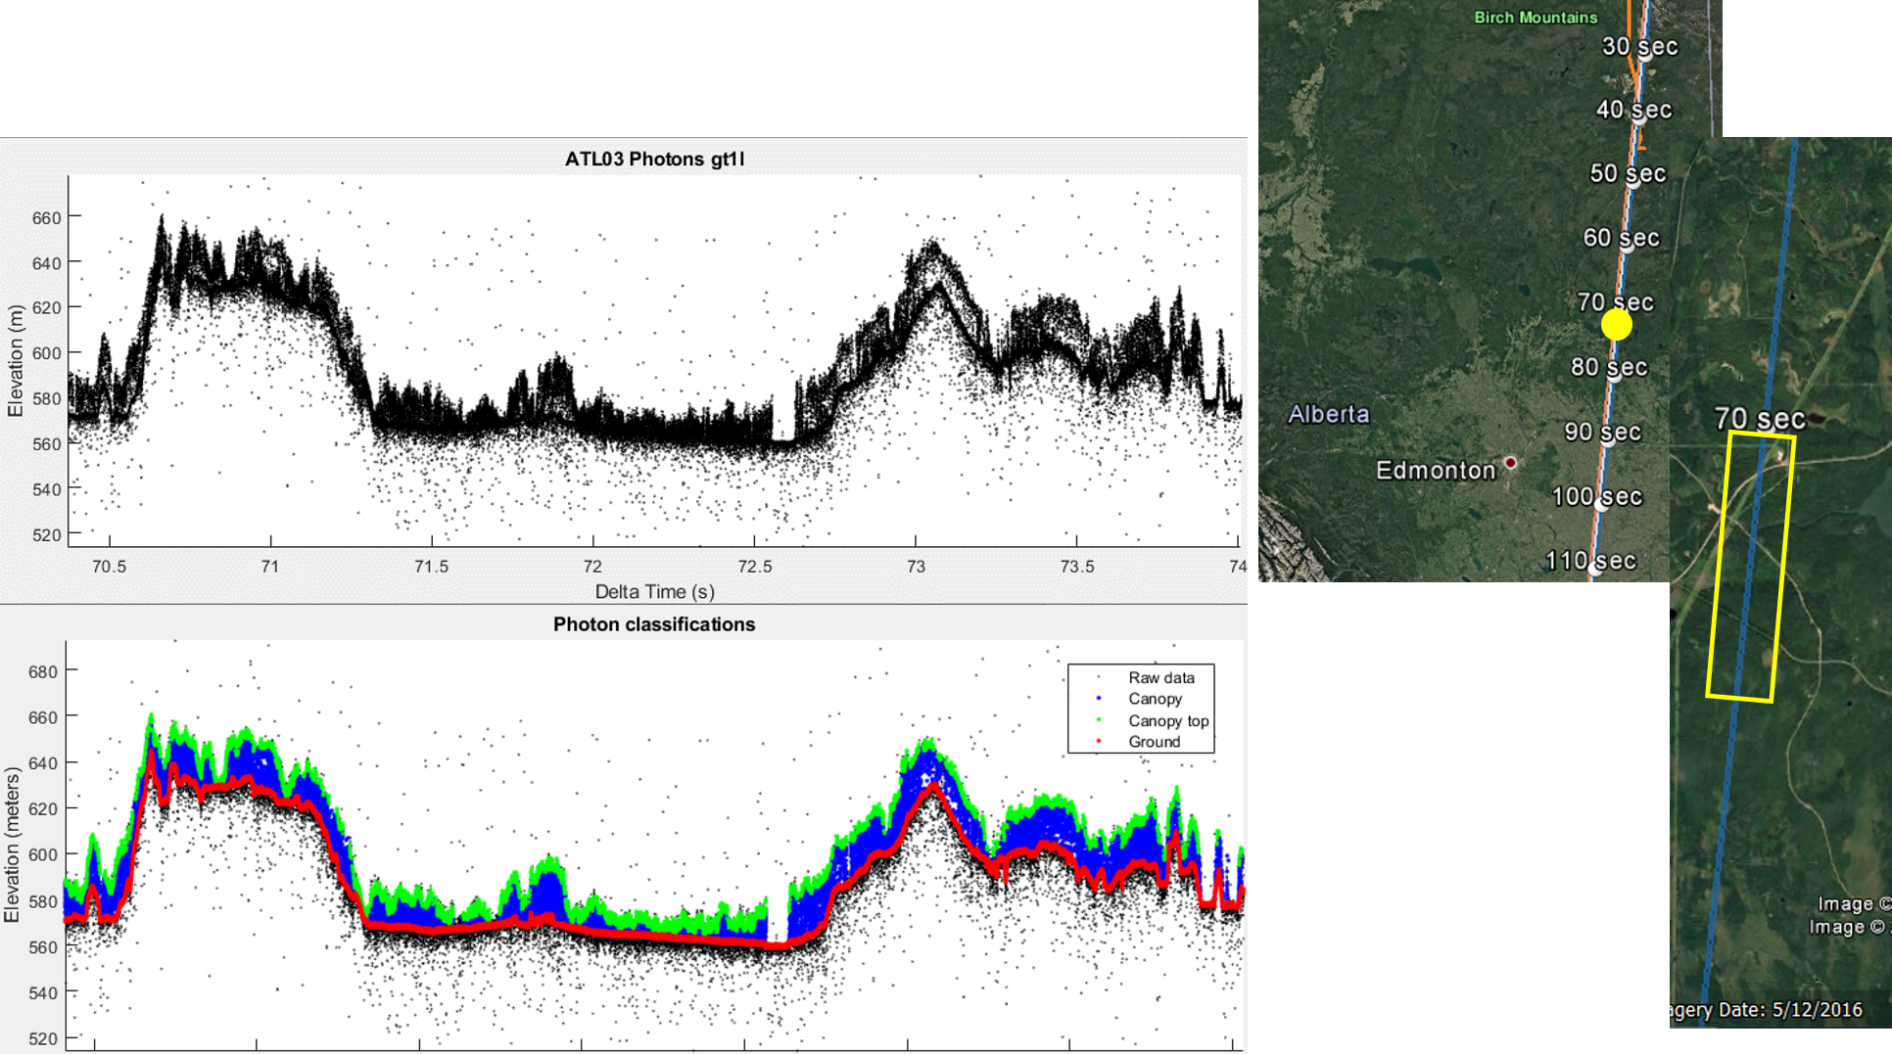
ICESat-2 has launched as it collecting data globally
Profile of ICESat-2 data through boreal forest NE of Edmonton, AB. ICESat-2 is a photon counting lidar system, so we need to establish new models to estimate biomass

Slide 4
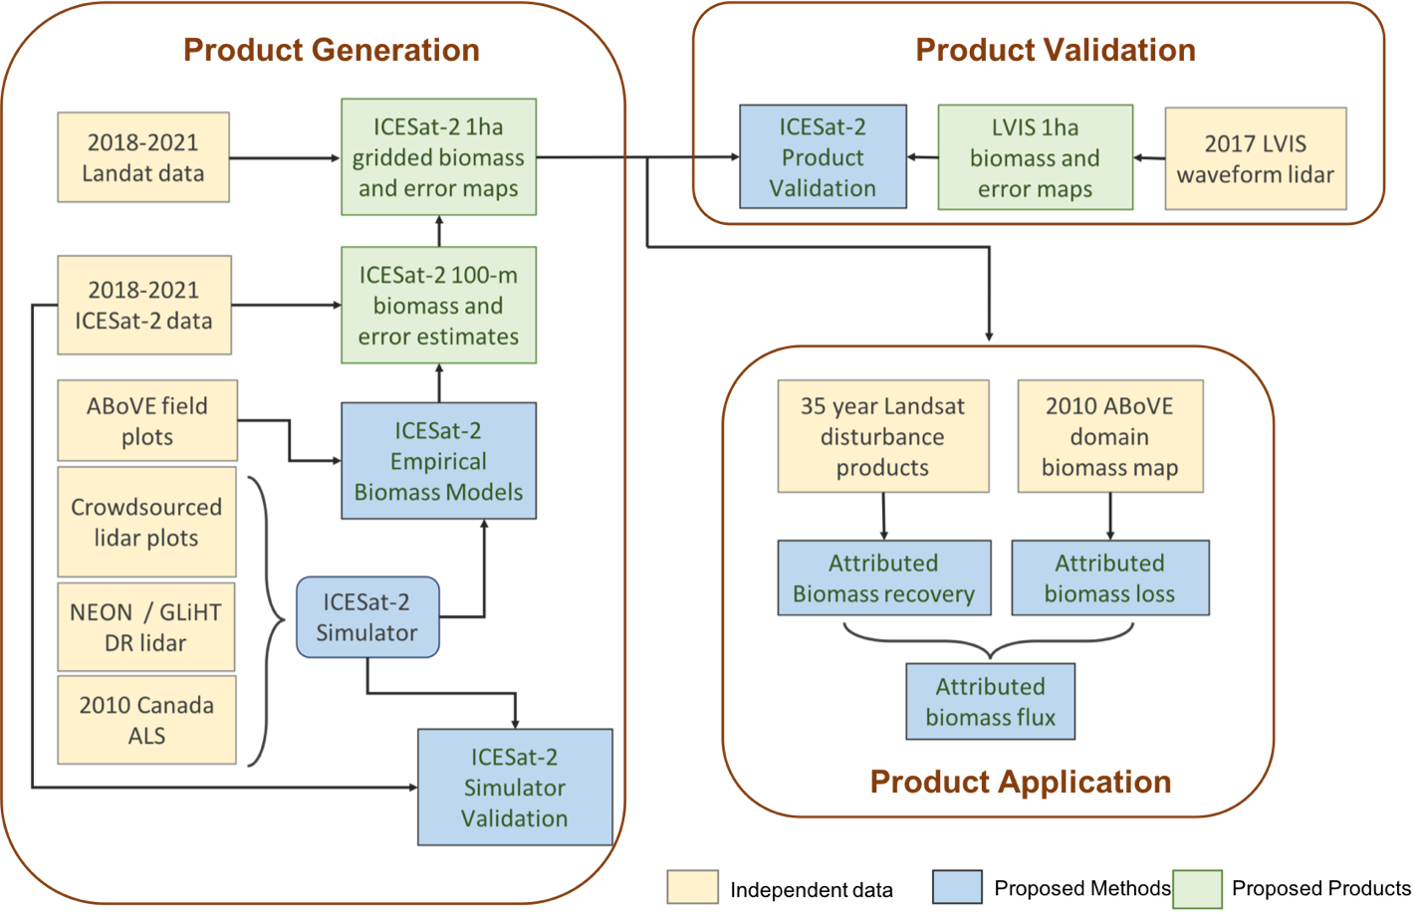
Methodology

Slide 5
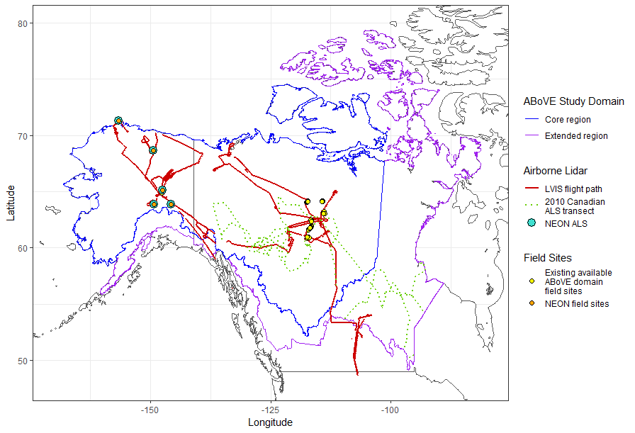
Remote Sensing
This is an RS focused project using multiple sources of airborne lidar, ICESat-2 and Landsat
NEON, GLiHT over field plots to simulate ICESat-2
LVIS over field sites to create validation airborne lidar maps
ICESat-2 and Landsat across full domain for ~2020 Biomass mapping

Slide 6
NEON ALS data will be used to simulate ICESat-2, and this simulator will be validated against coincident real ICESat-2 data. These sites will also be used, in combination with other ABoVE domain field and lidar sites, to build ICESat-2 biomass models.

Slide 7
Stakeholder Engagement
Collaborators Mike Wulder and Joanne White at the Pacific Forestry Center (Canadian Forest Service) are leading engagement with Canadian government
Peter Griffith and Collaborator Sabrina Delgado are working with potential first nations stakeholders at Great Bear Lake

